Slide 1

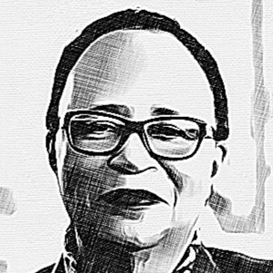

ShirleysList
Team 13

Slide 2

Agenda
1. Our Goal
2. Our Team
3. Project Information
4. How it looks
5. Value

Slide 3
How’d you get that leather couch?
Some kid at Rahps A

Slide 4

An Overview: Our Goal
Create a platform where RPI students can sell "student items" safely and easily.

Slide 5

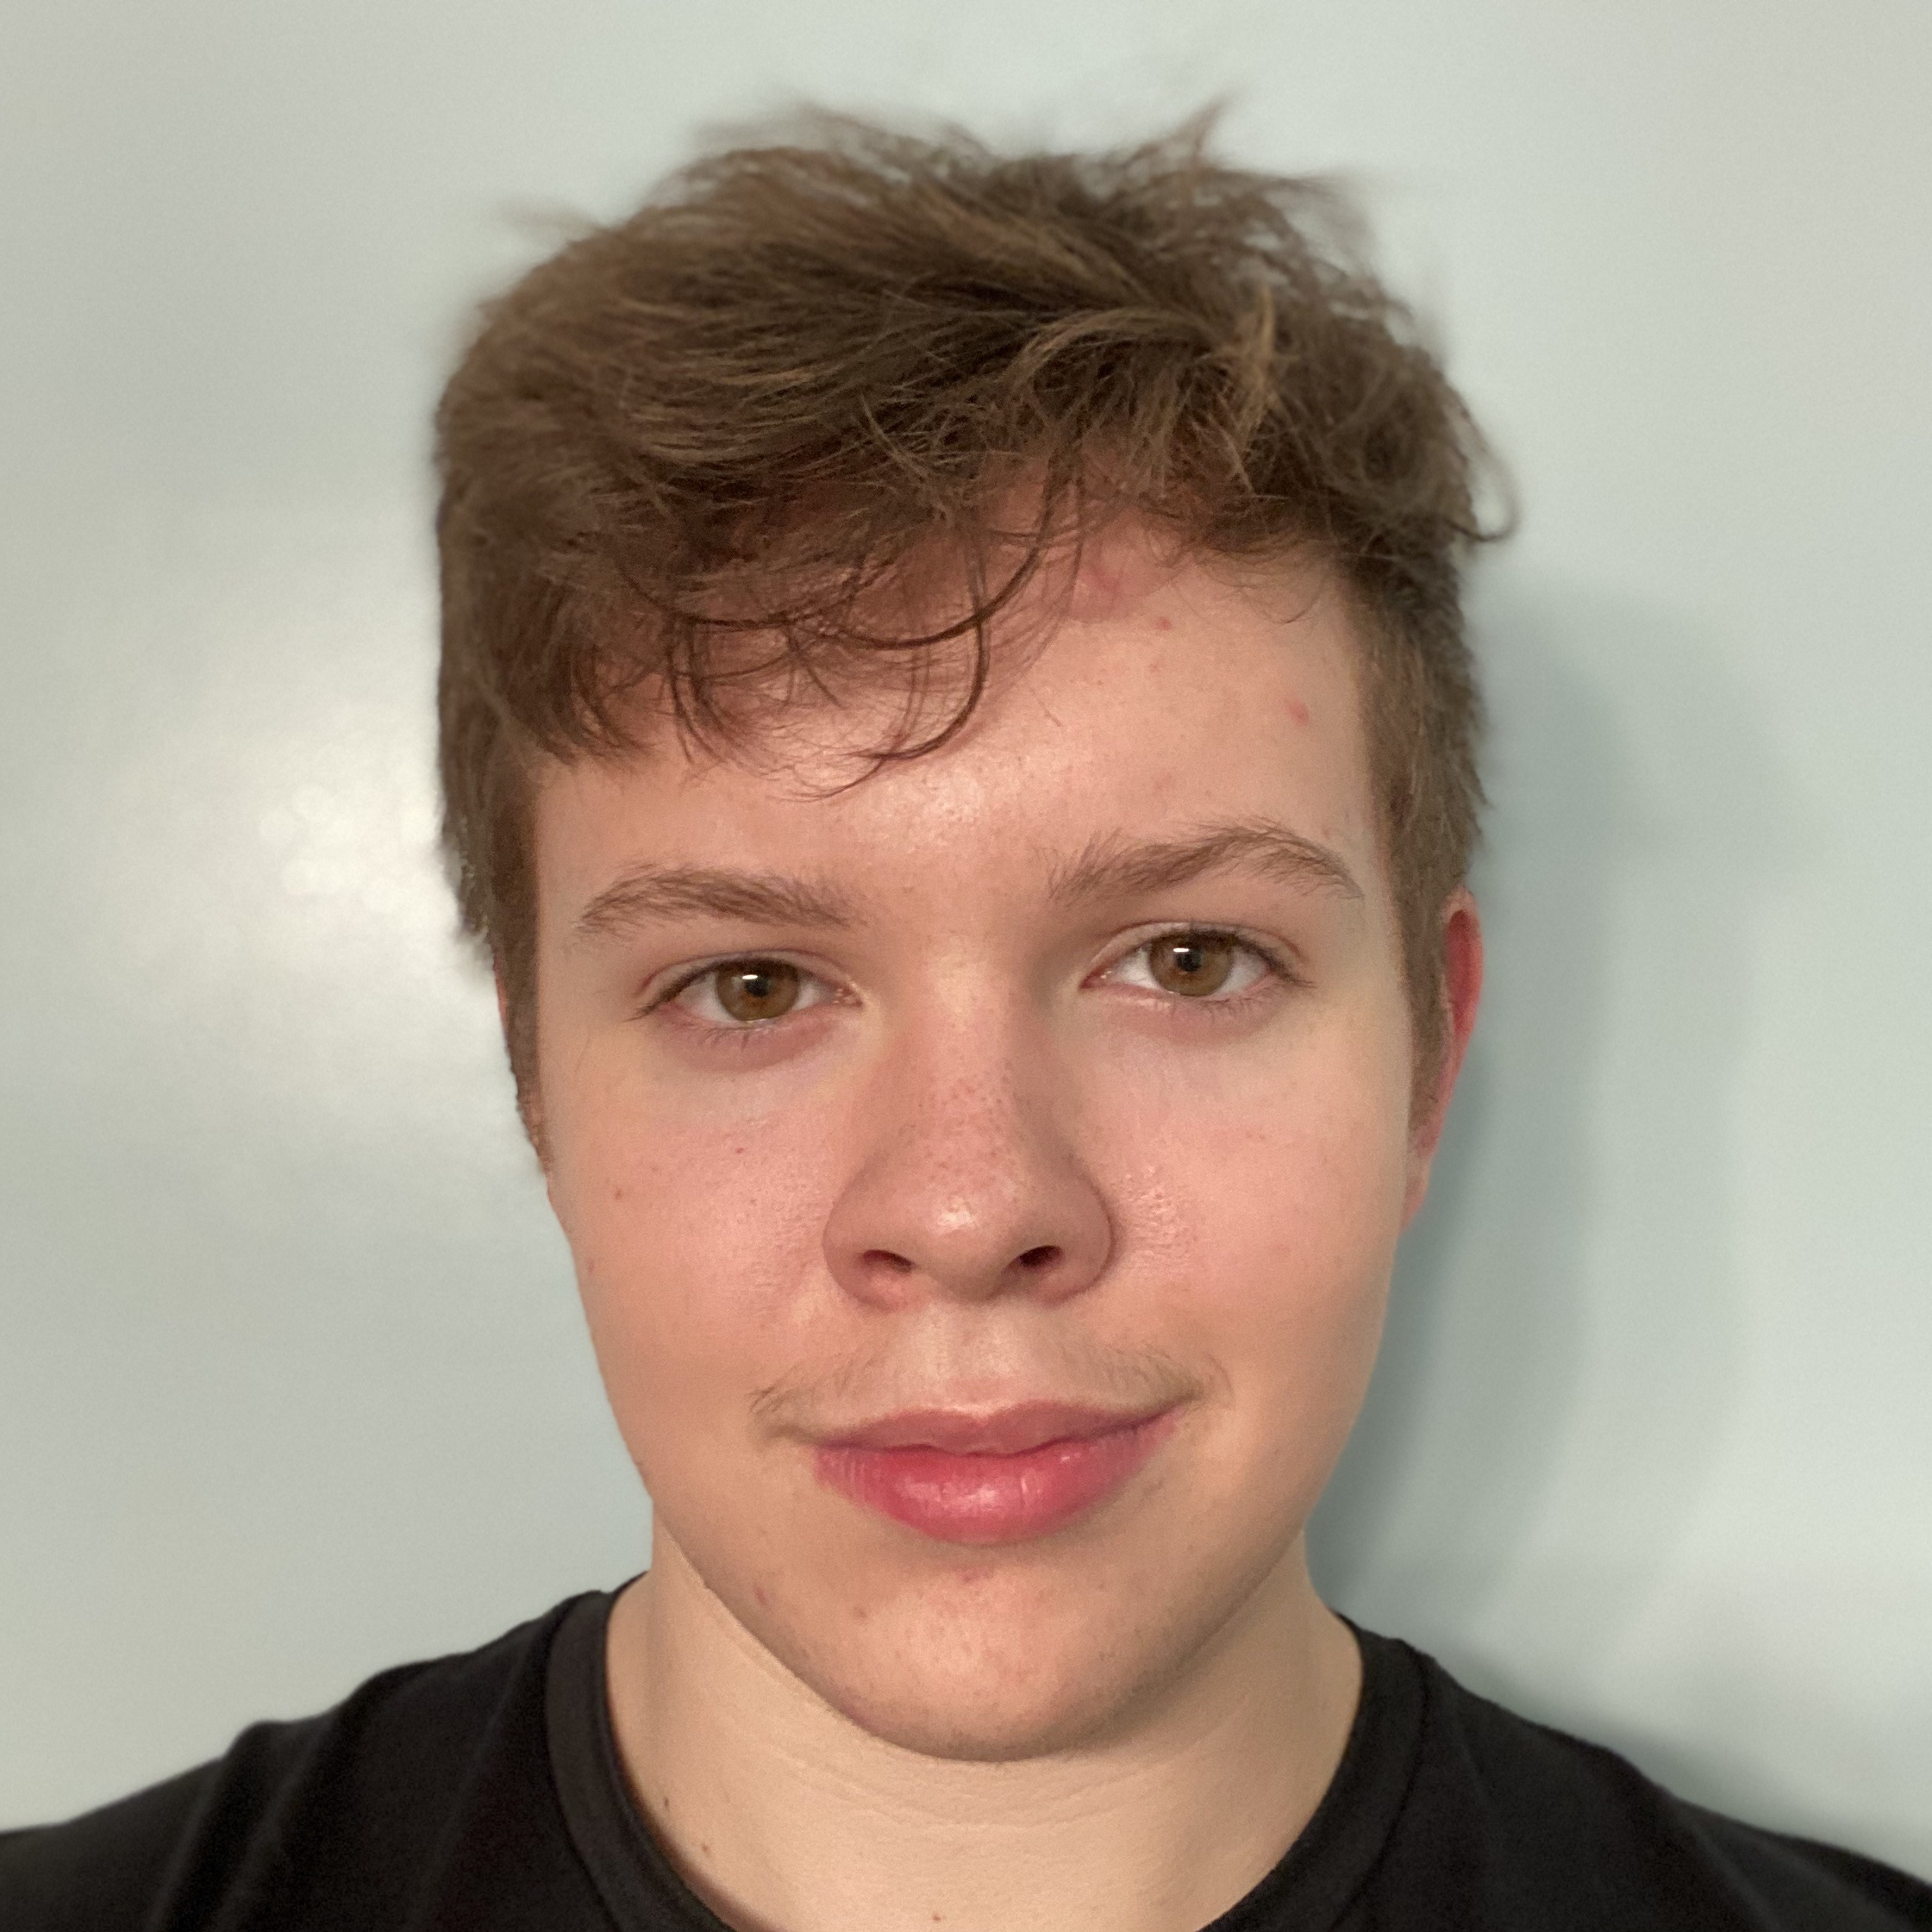
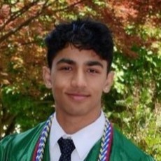
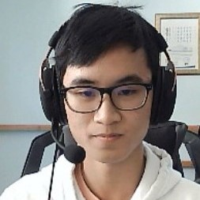
MEET OUR TEAM
Cian Howell
Aaryaman Thuloj
Teammate
Teammate
Samuel Leung
Teammate

Slide 6






TECHNOLOGY STACK
HTML, CSS, and JavaScript for core website features
Bootstrap's functionalities for layouts, responsiveness, and UI elements.
PHP for backend connections, mainly to an SQL Database of entries
Integration of RPI's login system
Of course, GitHub

Slide 7
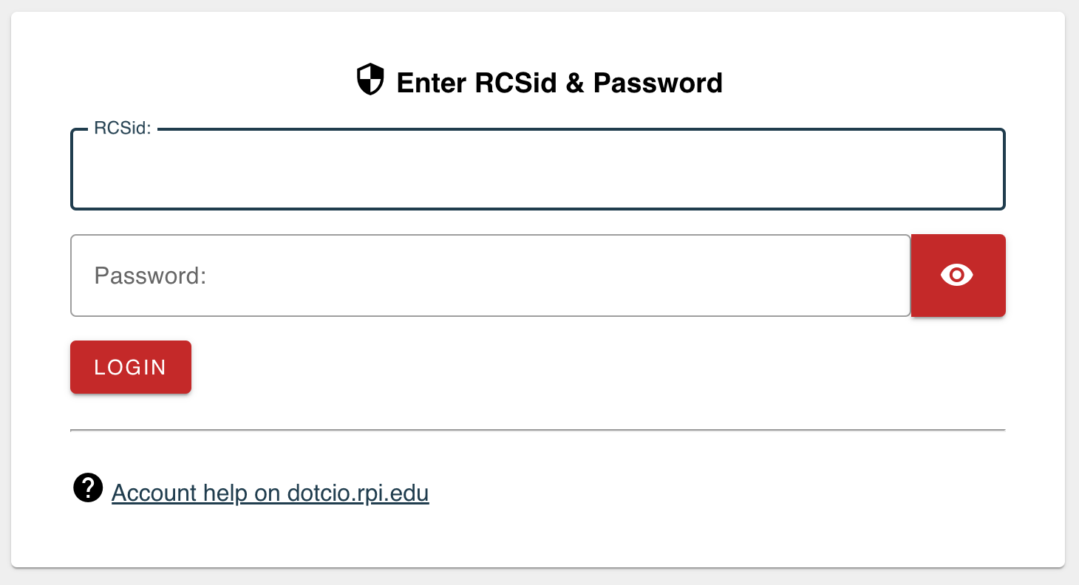
REQUIREMENTS
Advanced website design training
Refresher on forms and databases
Hosting
Access to RPI's Central Authentication System!!

Slide 8
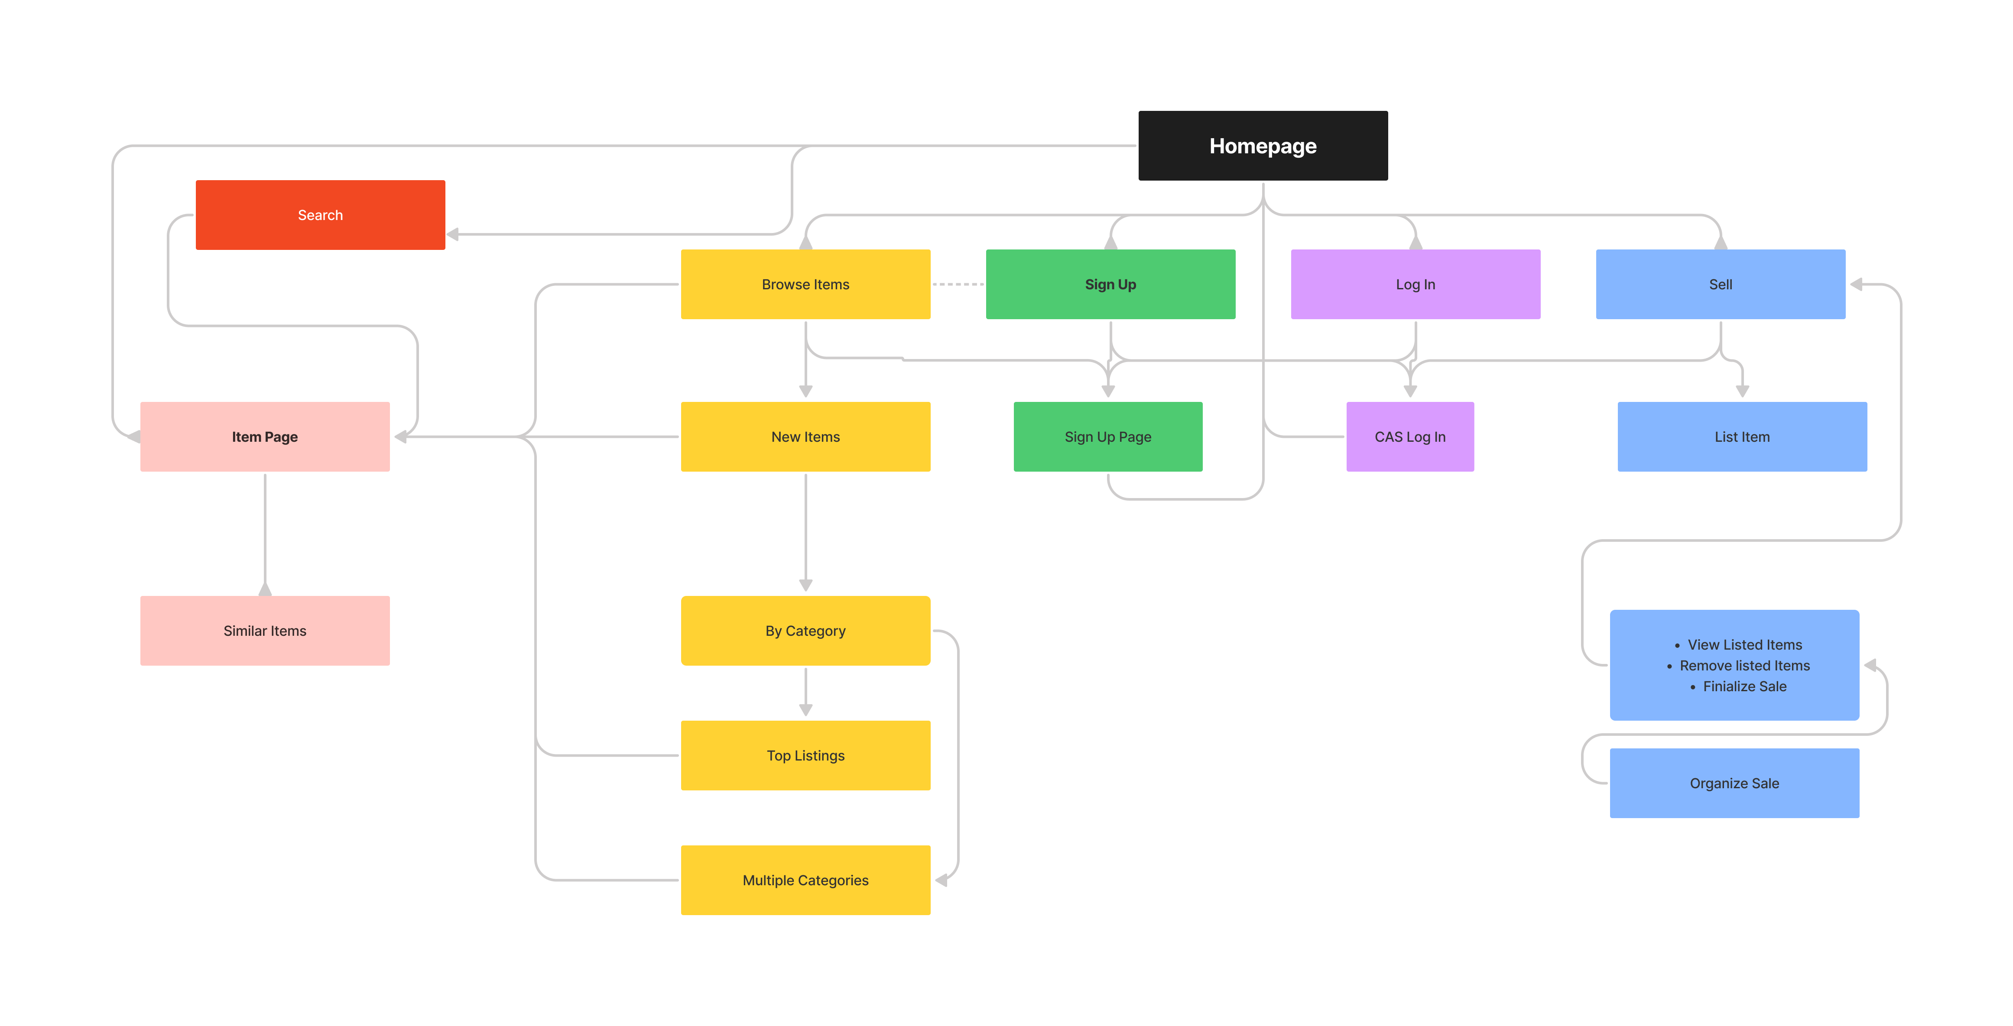
Site structure

Slide 9
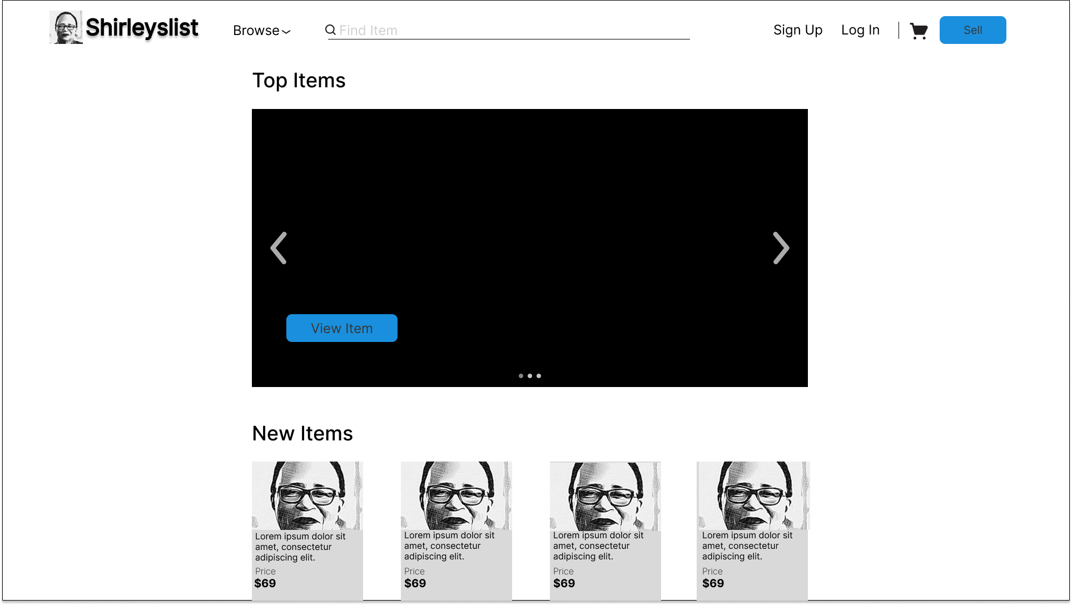
Homepage

Slide 10
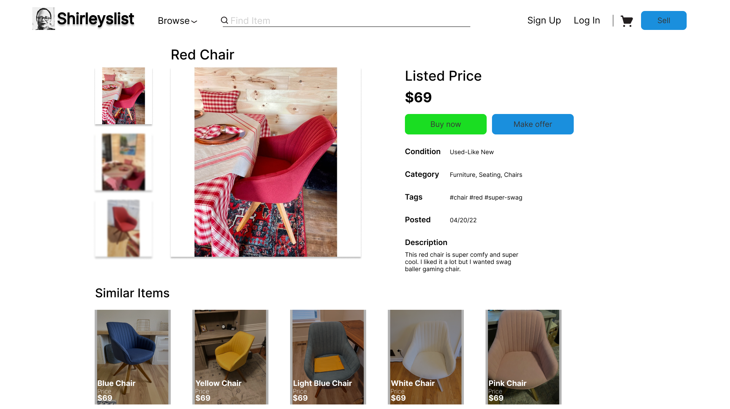
Listings page

Slide 11




User Value
Target demographic is RPI students
Takes a lot of risk out of meetups (RPI Auth. Required)
Little to no transportation to buy/sell
$$$

Slide 12
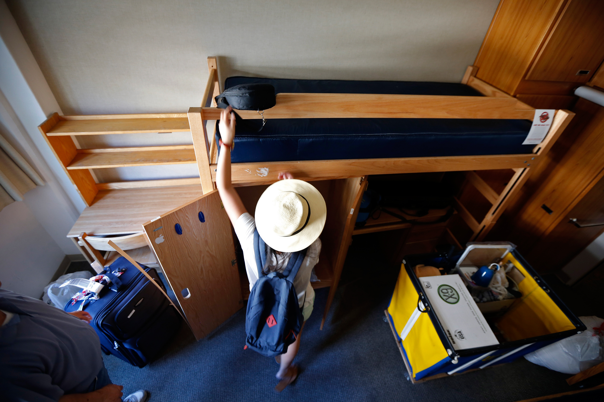

Stakeholder value
Parents:
Peace of mind during move-in
RPI Faculty:
Sell old furniture when replacing, reduce waste
Students:
Easy meetups, especially without a car
Public Safety:
Entries can be easily logged, if anything does go wrong

Slide 13

PROJECT TIMELINE
Start September 24th:
- bootstrap practice
- javascript refresh
- basic site complete
- some styling done
By October 10th:
- styling mostly done
- functional backend
- get rpi cas access
By December 7th:
- Project complete
- Hosted website
- visually appealing with hci principles in place

Slide 14
Sprint Timeline
Sprint | Date | Group Members | Goals
1 | 9/24－10/10 | Group Aaryaman Sam Cian | Rough HTML, CSS, and Bootstrap. Research on CAS implementation Research on data structure Start on SQL and PHP
2 | 10/10－10/24 | Cian Aaryaman Sam Group | Basic Implementation of showing items Basic Implementation of user sign in Designing the SQL database JavaScript functionality and interactivity
3 | 10/24－11/08 | Cian Sam Aaryaman Group | Basic Implementation of buying and selling Refine database Integration of CAS system
4 | 11/10－11/24 | Aaryaman Sam Cian Howell Group | Interim Release Unit Testing, System Testing Refine User Interface Combine finished components
5 | 11/24－12/8 | Cian Sam Aaryaman | Prepare for the Final Release and Presentation System Testing Debugging

Slide 15
Wow! Shirleyslist got me a leather couch!
Future Rahps A kid, hopefully

Slide 16

THANK YOU!!

